Slide 1

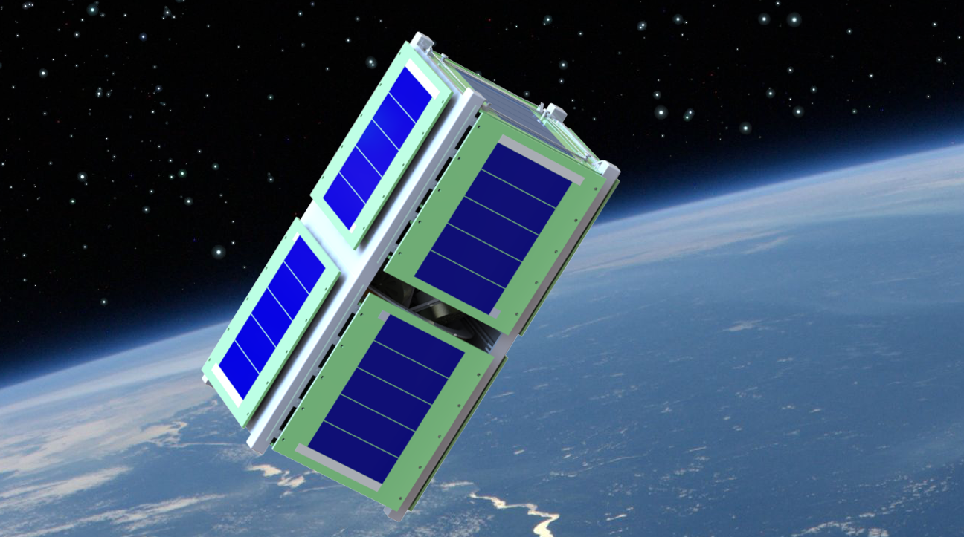
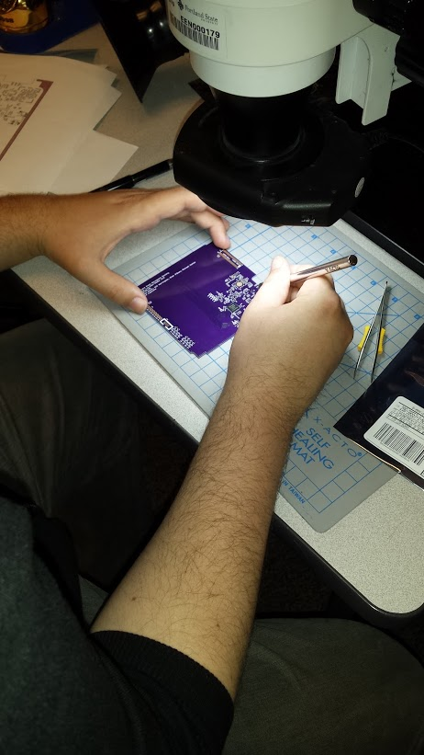
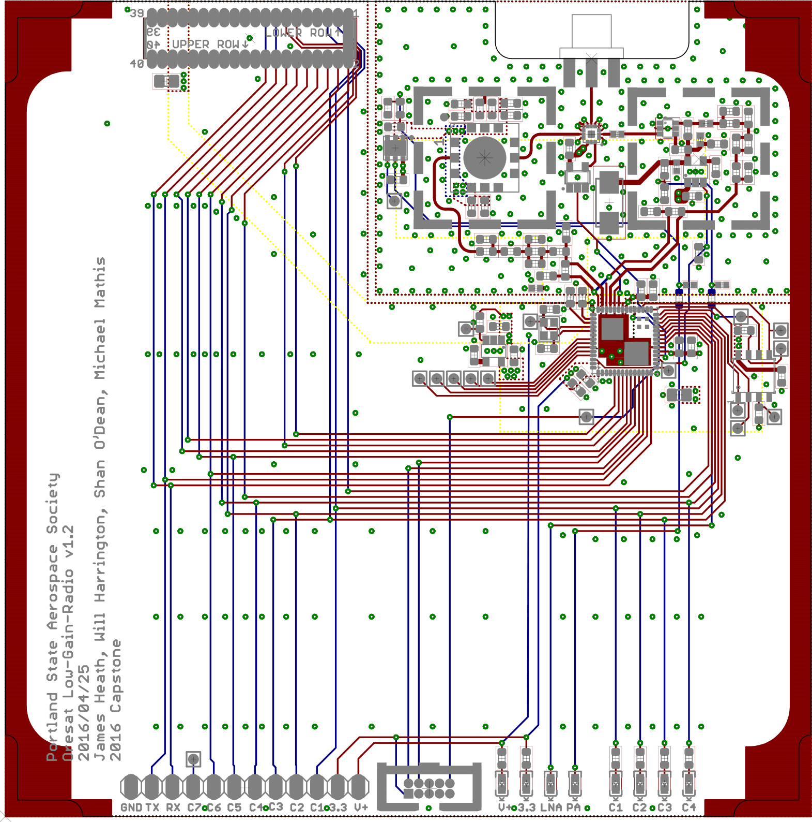
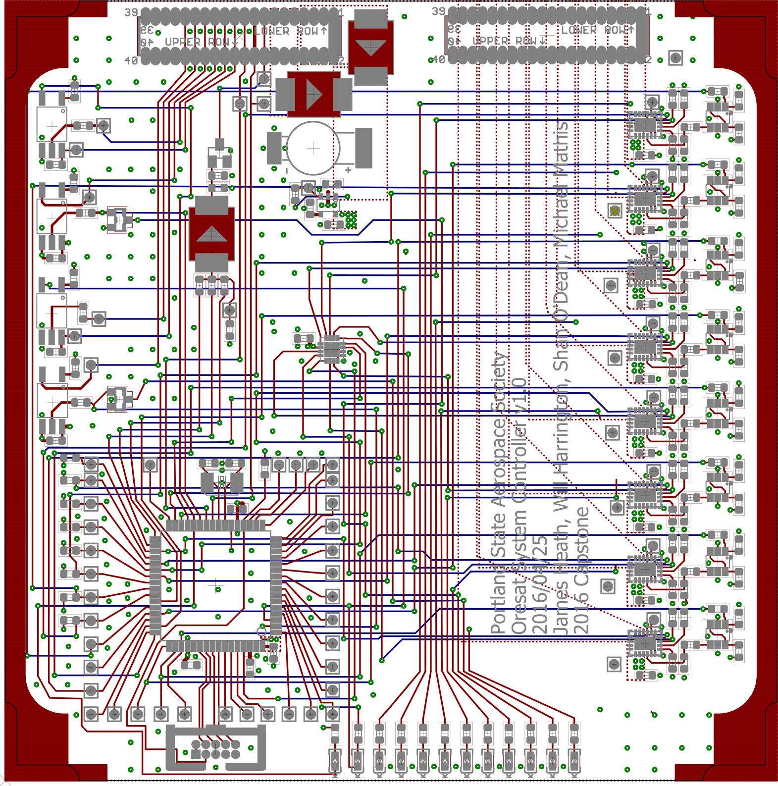
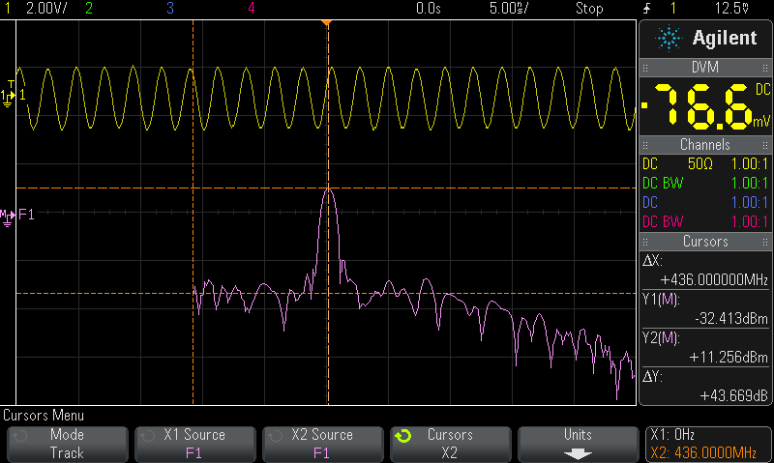
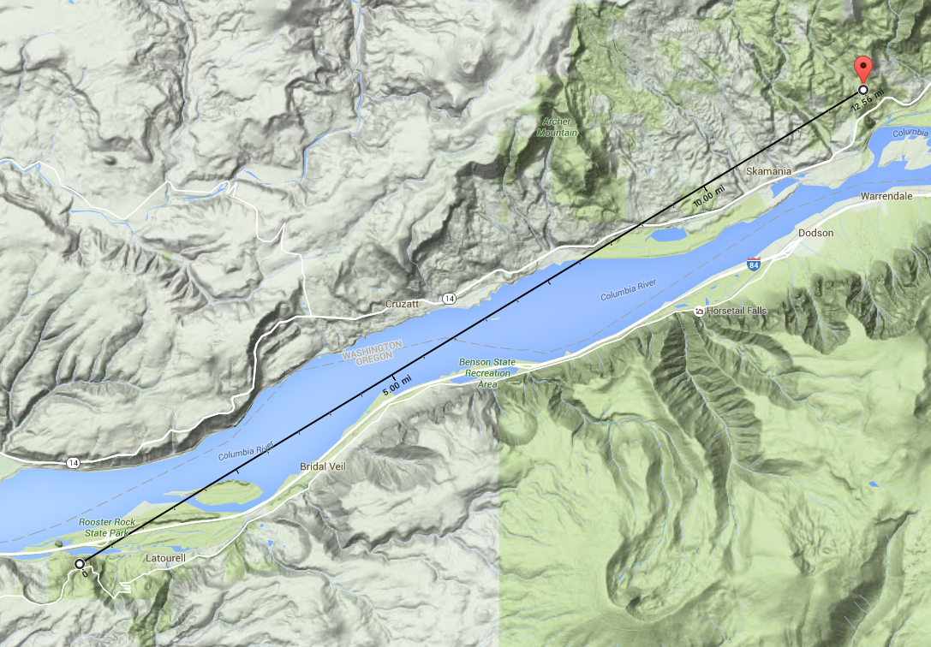
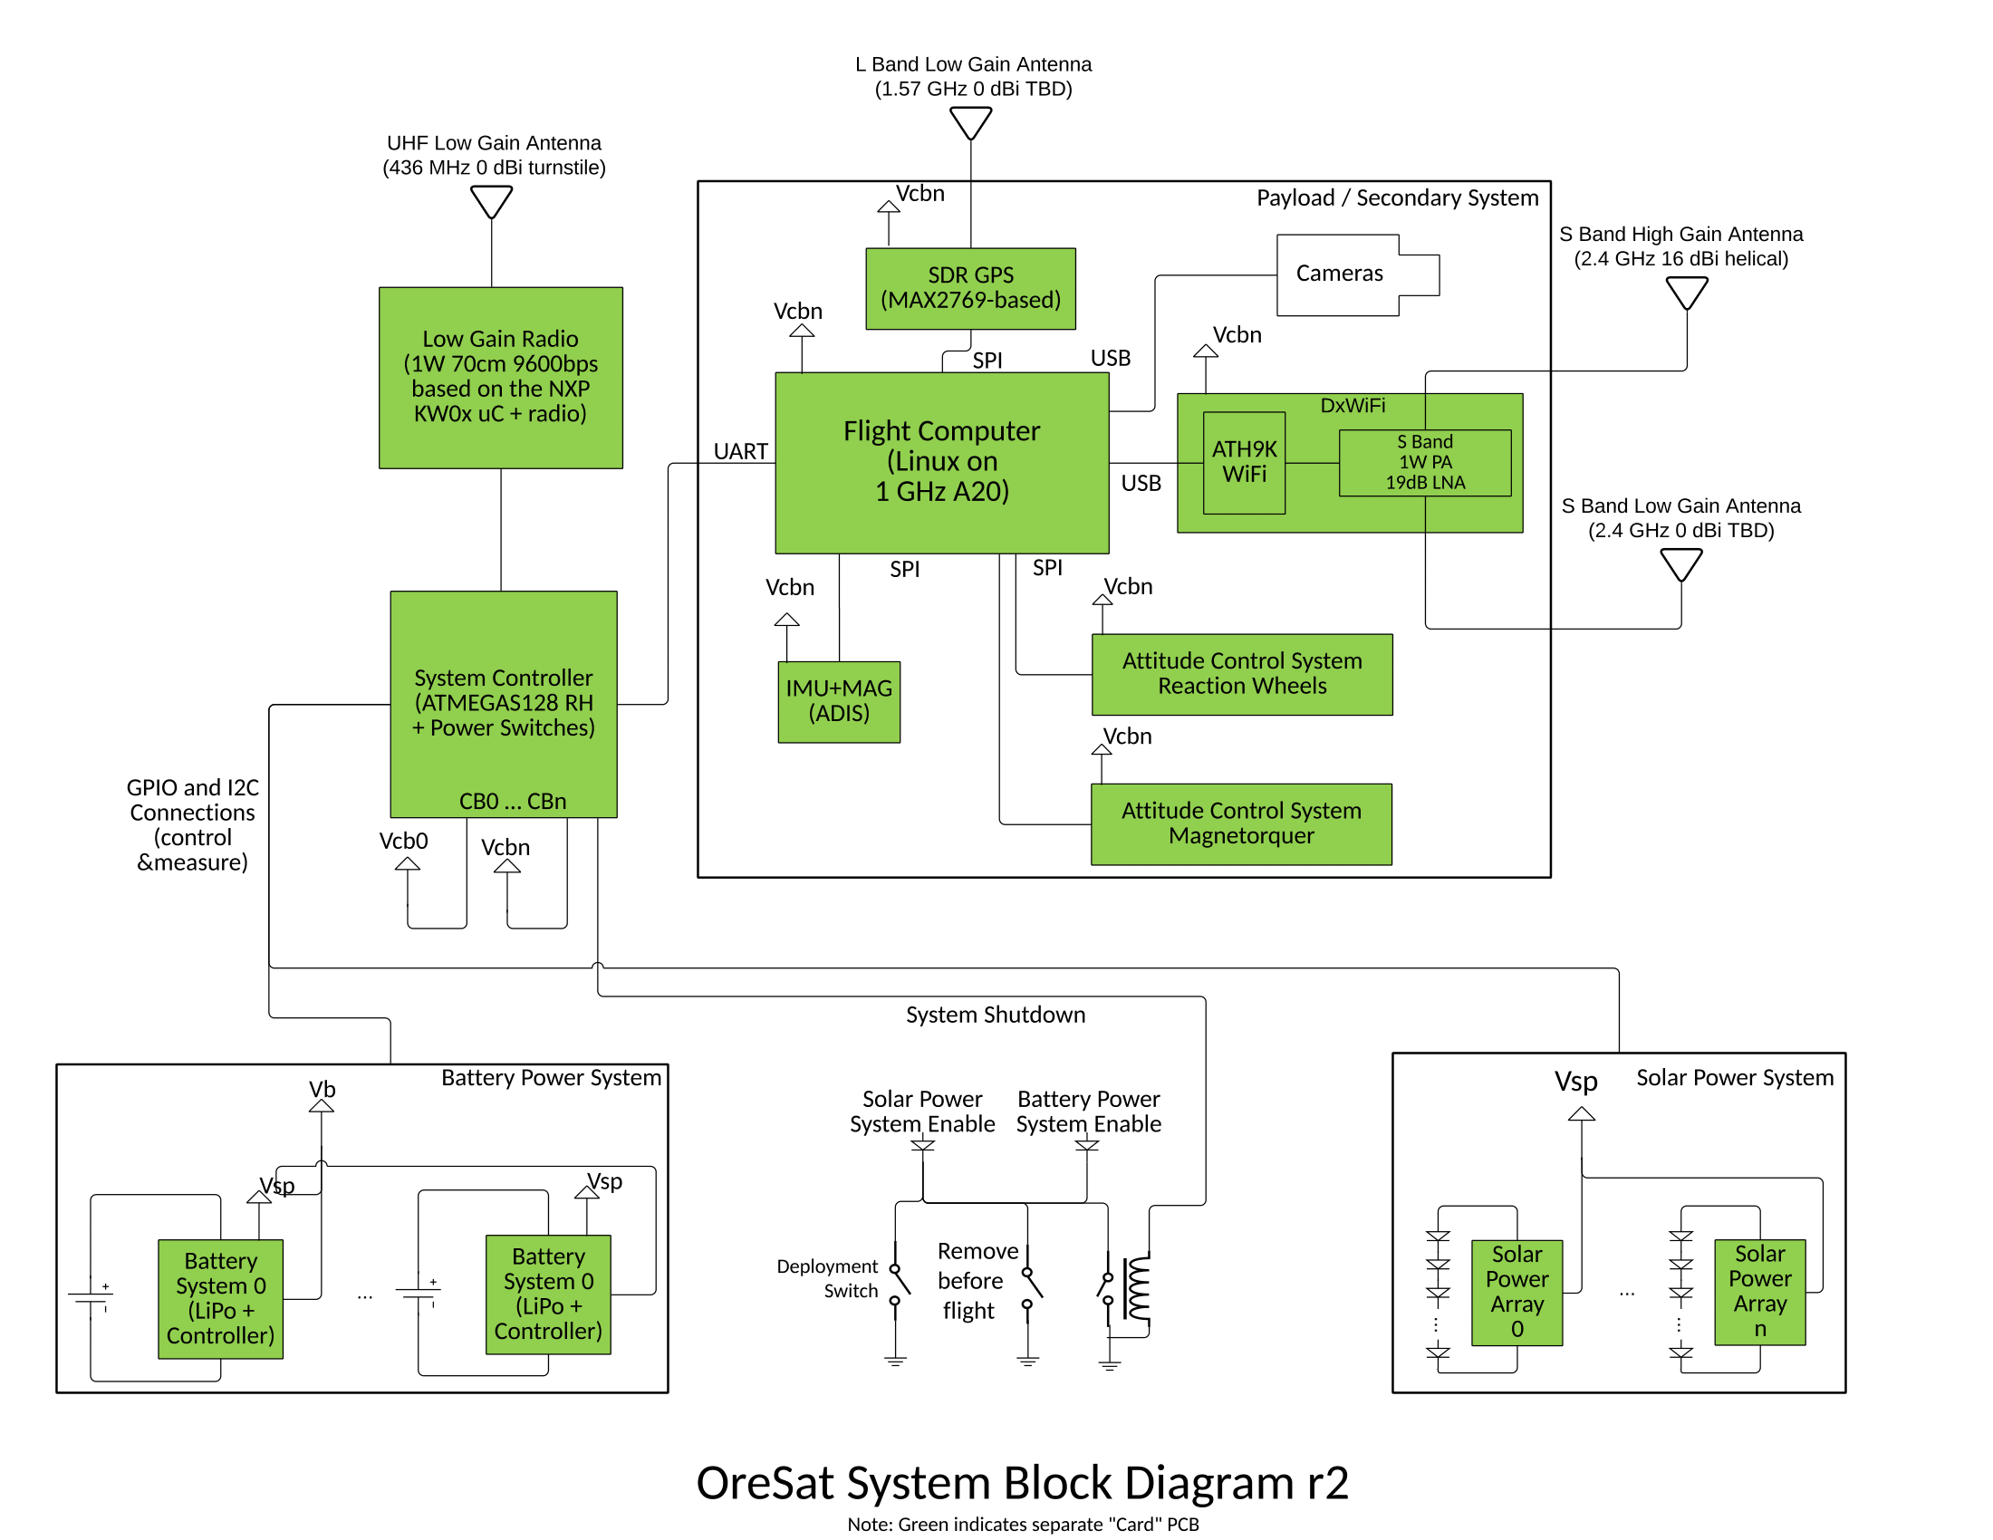
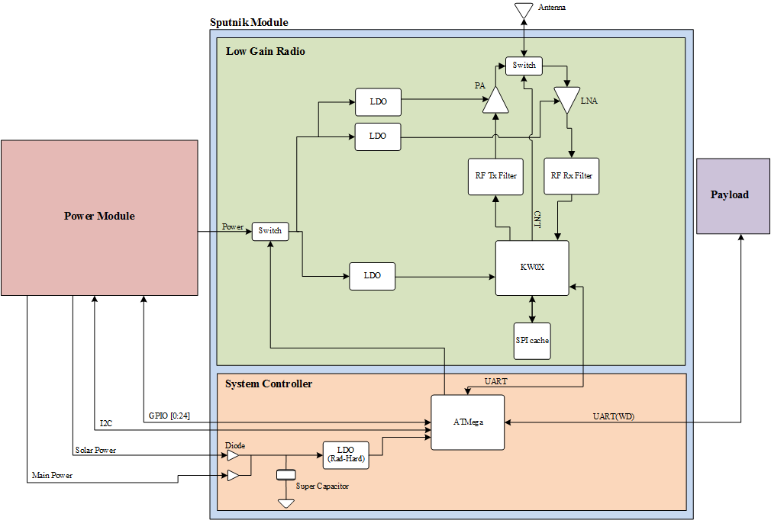
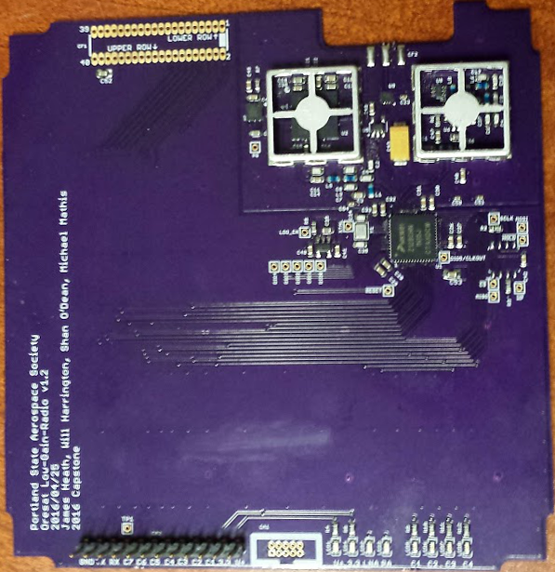
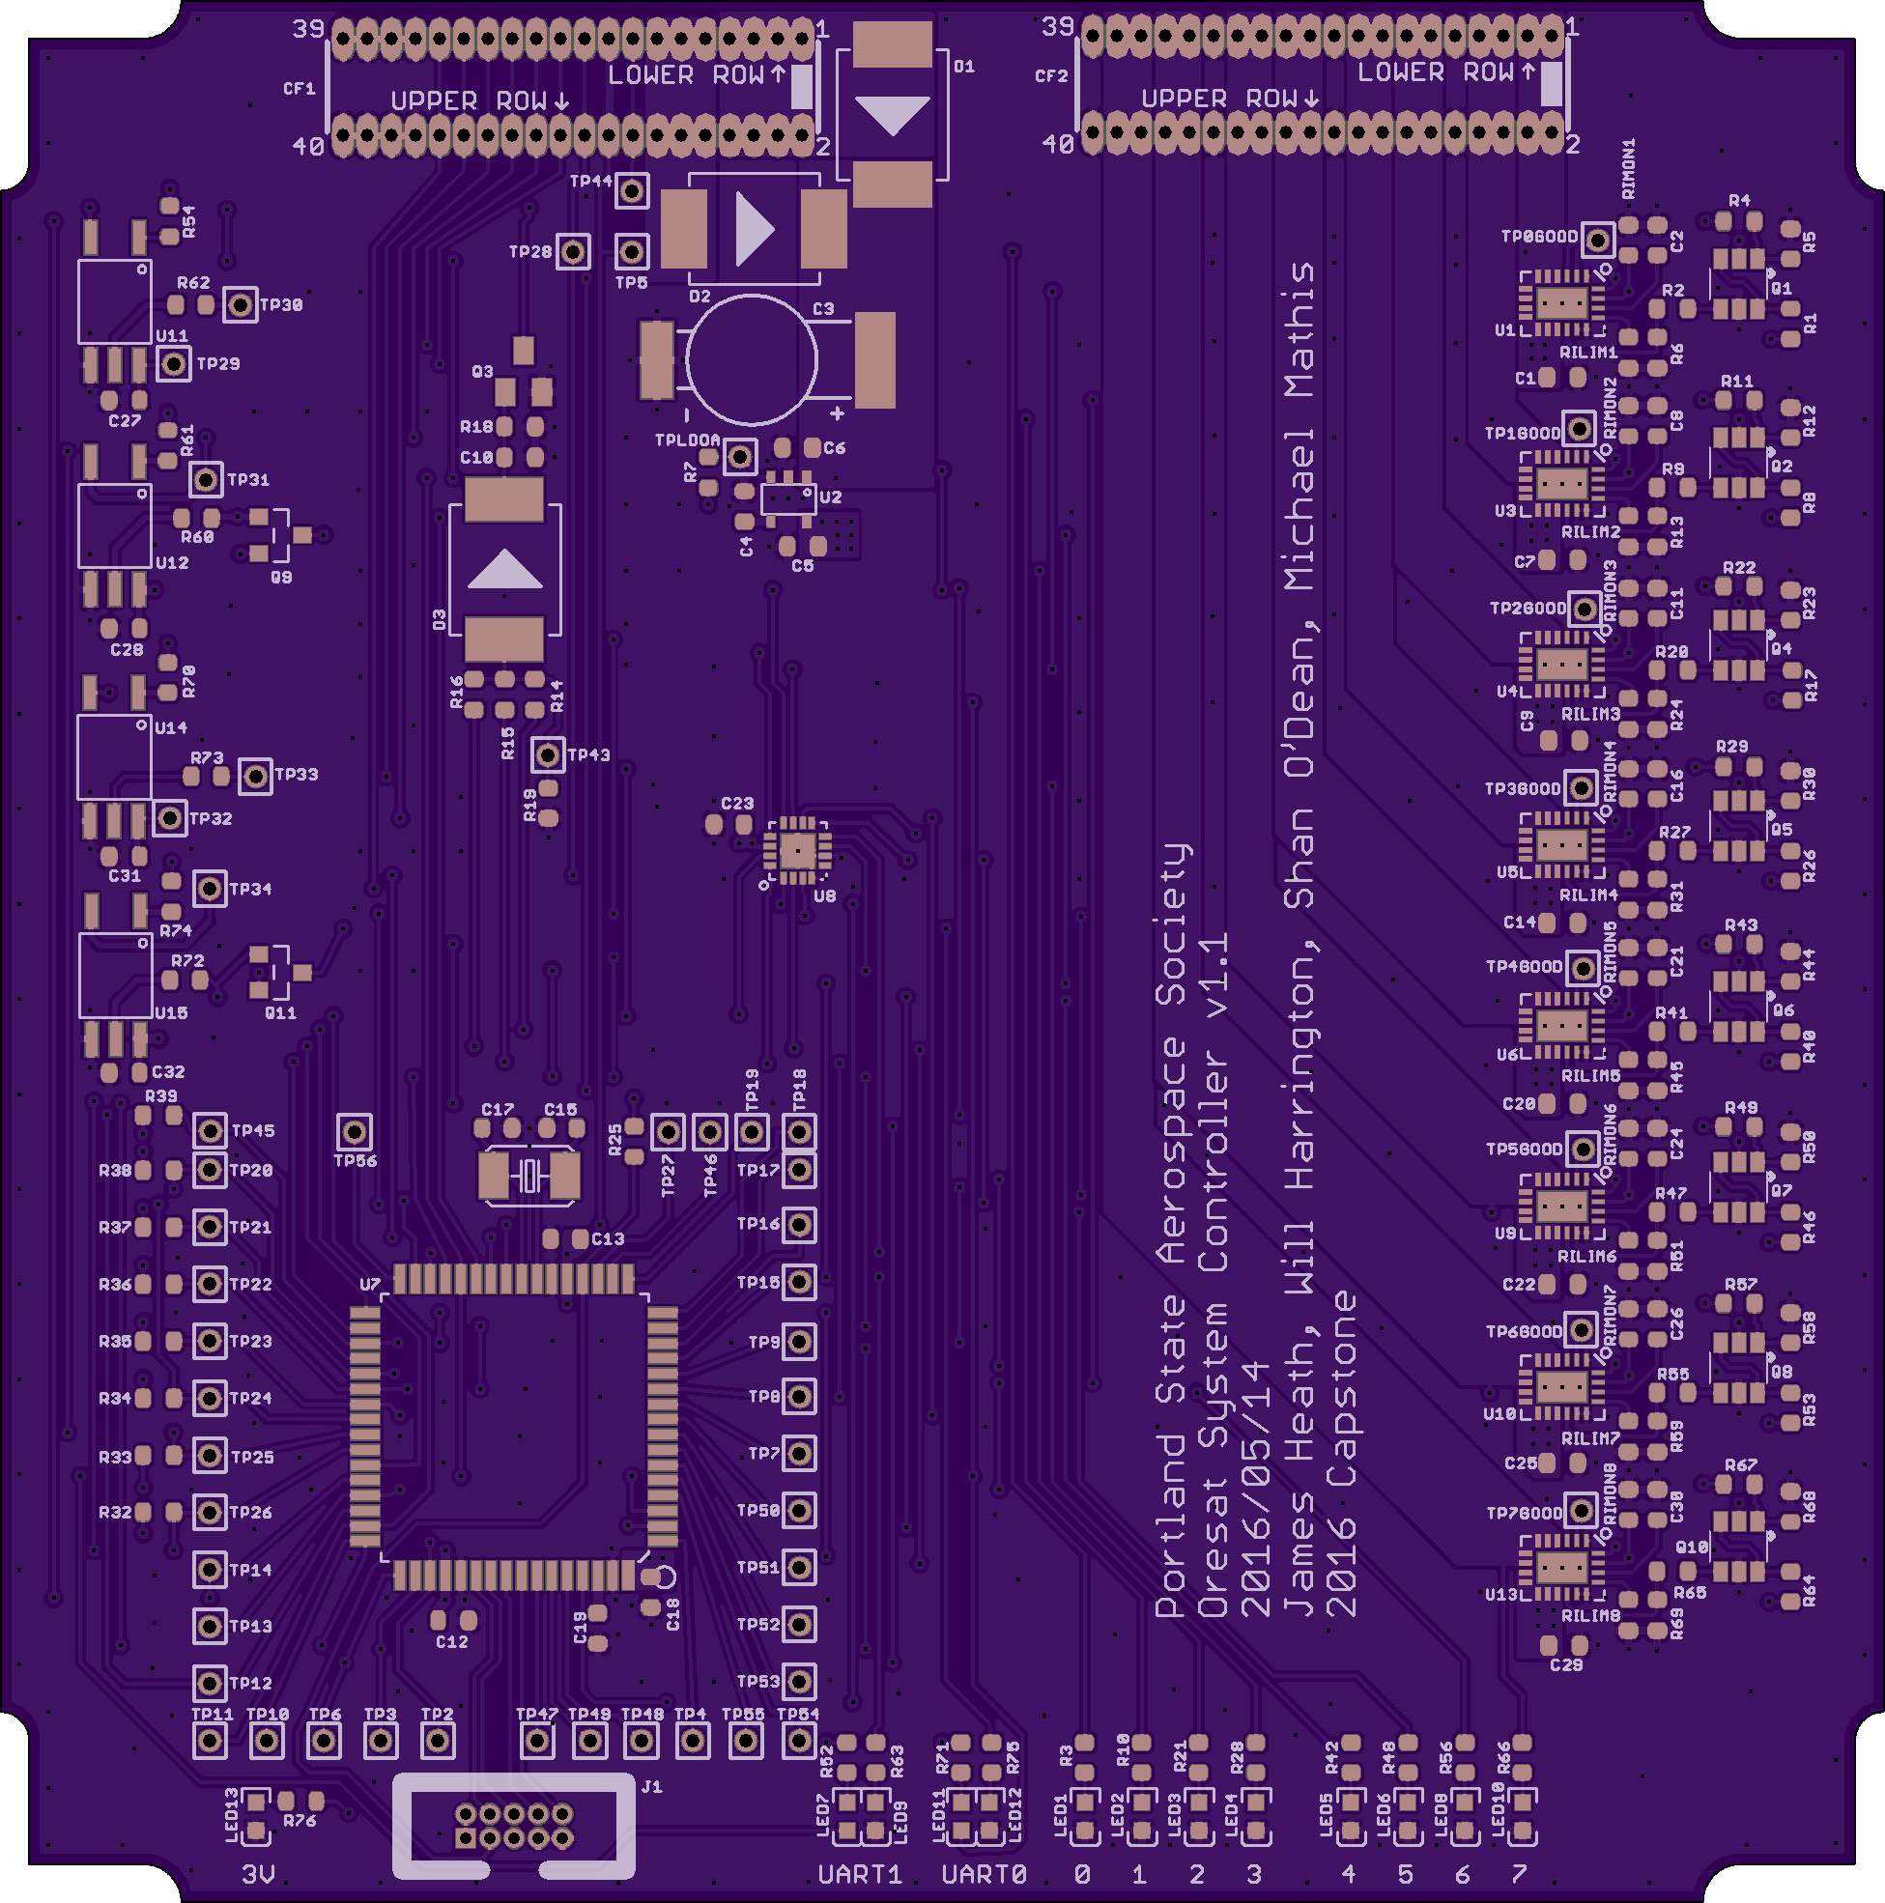

CubeSat Command Control
and Communications System
Project Team:
Will Harrington
Jake Heath
Michael Mathis
Shan Quinney
Special Thanks to:
Andrew Greenberg Theo Hill
Glenn Dr. Teuscher
PSAS The LID
Introduction
Current Results
The Portland State Aerospace Society (PSAS) is the lead on the Oregon Small Satellite Project. “OreSat” is a CubeSat form-factor nanosatellite designed for a low-earth orbit of 400 km.
As of 5/24/2016 the accomplishments of the project include:
Finished Low-Gain Radio board
Current limited power tests have worked
Carrier signal at desired power and frequency has been transmitted
Working on packet transmissions
Finished System Controller design
Waiting for board delivery to commence building
Firmware complete on evaluation board.
OreSat requires a robust command, control, and communication (C3) system to control the satellite. The C3 system must communicate to the ground over 1,400 km (at acquisition of signal) at low data rates (9600 bps) while monitoring and controlling the power system of the satellite.
Design
Jake Heath working on an LGR module
We split our design into two parts, the Low-Gain Radio (LGR) which handles communication and the System Controller (SC) which is in charge of command and control for the module
The boards need to be cut in order to fit properly.
The layout of the LGR (left) and the SC (right)
Our design is only two of the many modules in OreSat. The LGR is used for communication with the Cubesat, supplying 1 Watt of transmission power to cover the long distance. The System Controller, which will be accessible from the ground station via the LGR, will inform the ground crew in the case of radiation latch-up and can restart the whole satellite if necessary.
Little Beacon Rock
Vista House
Carrier Signal (Left) and the 10km test location (Right)
Completed boards for the LGR (left) and the SC (right)
Pictures of the finished boards LGR (left) and SysCon (right)
Department of Electrical and Computer Engineering

